Slide 1

After Call Survey INSIGHTS
Diana Hatfield​​

Slide 2

Purpose
This presentation analyzes post-call survey feedback from the member’s perspective, capturing how members rate their experience when interacting with Dental call agents.
It provides valuable insights into why members contact our call center and how those interactions are perceived, enabling us to identify key areas of opportunity as well as call types where performance is strong.
Notes:
Purpose of analysis – Data from 01/2024 – 04/2026
What questions you are answering
Why are members calling?
Where are we underperforming?
What are we doing well?

Slide 3

Methodology
Data Source: Post-call member survey responses collected between January 2024 to April 2026.
Scope: 64,543 survey responses across all Lines of Business (LOBs).
Analysis Dimensions: Call Reason, Line of Business, NPS Dental, FCR, Ease, Informed, and Courtesy.
Classification:
High Raters: FCR= 1-2; Ease, Informed, Courtesy, and NPS =4-5
Low Raters: FCR≥3; Ease, Informed, Courtesy, and NPS =1-3
Objective: Identify drivers of member satisfaction and dissatisfaction and highlight opportunities to improve the member experience.
Tools:
Python/Jupyter
Pandas
Seaborn
matplotlib
numpy
Data Cleaning & Transformation:
Blank survey responses were standardized to ‘0’ and cleaned for reporting consistency.
Converting data types from Date and Time to Date
Renaming columns
Converting Call ID to Respond ID

Slide 4





Member journey
Member contacts the call center
Agent assists the member
Survey feedback captured
Member routed to survey
Call end
Notes:
Member Journey/Process flow
Member contacts DentaQuest call center
Agent assists the member
Member routed to survey
Feedback captured

Slide 5
Survey Questions
NPS Dental
On a scale of 1 to 5, where 1 is not at all likely and 5 is extremely likely, how likely are you to recommend your Dental services to a friend or family member?
Ease
On a scale of 1 to 5, where 1 is very difficult and 5 is very easy, how easy is it for you to do business with Dental Customer Service?
Informed
On a scale of 1 to 5, where 1 is strongly disagree and 5 is strongly agree, how much do you agree that the representative gave you the information or help you needed ?
Courtesy
Call Reason
First Call
Including today’s call, how many times have you contacted us to completely resolve your issue?
On a scale of 1 to 5, where 1 is strongly disagree and 5 is strongly agree, how much do you agree that the representative treated you with courtesy and respect?
What was the primary reason for your call today? Press 1 to find a dentist, Press 2 for appointments, Press 3 for questions about your dental benefits or Press 4 for other.
Notes:
Survey Overview - 5 Survey questions: NPS, FCR, Ease, Informed, Courtesy + Call Reason

Slide 6
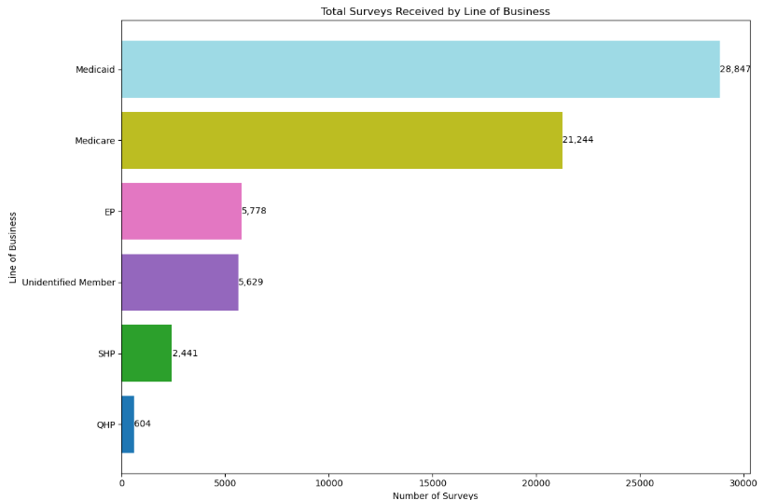
Total surveys received
Surveys received between 01/2024 – 04/2026
surveys
Medicare and Medicaid drive most of the survey volume and represent the greatest influence on overall member experience performance.
Other lines of business contribute comparatively less, reinforcing the need to prioritize Medicare and Medicaid for improvement efforts and strategic focus.
Notes:
64,543 Total Surveys received. Insight: Which LOB drives highest volume of survey received

Slide 7

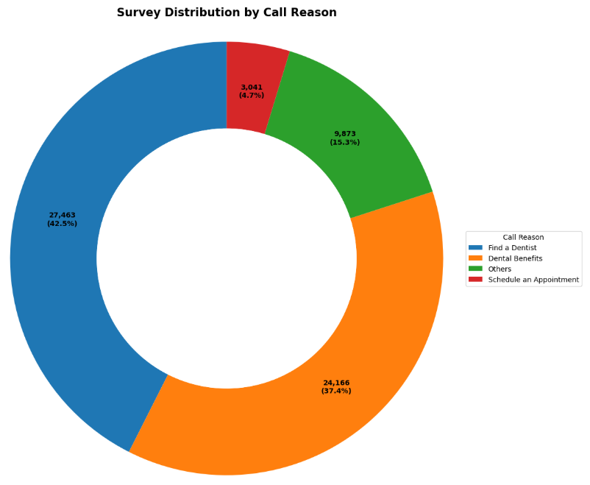
Call Reasons
Primary Drivers of Member Contact
Call reasons
“Find a Dentist” 42.5% and “Dental Benefits” 37.4% are the largest drivers of member contact and survey volume, indicating that provider access and benefit-related inquiries are the most significant factors shaping the member experience.
Notes:
Call Types Distribution, Top Call reasons chart. Insight: What drives member contact

Slide 8

Low Raters understanding Drivers of dissatisfaction

Slide 9

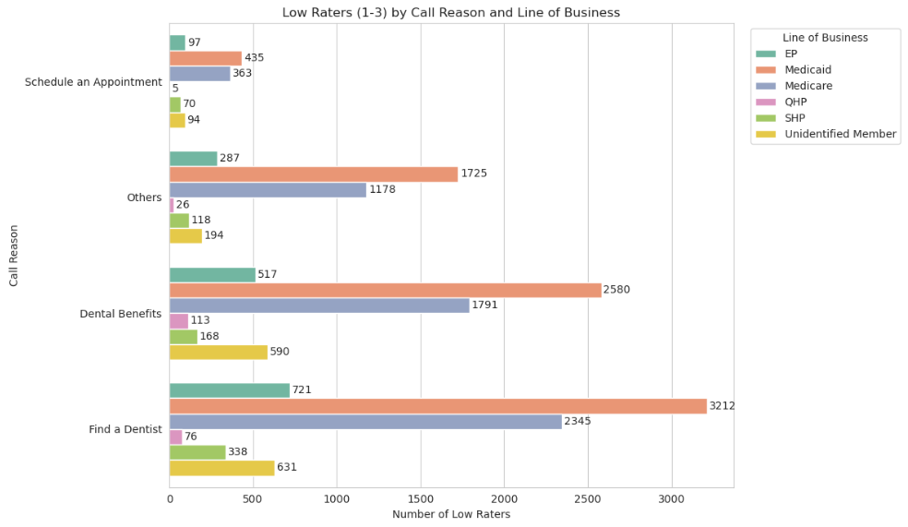
Low raters
Drivers of Member Dissatisfaction
Find a Dentist
Leading call driver and primary source of dissatisfaction.
Line of Business
Medicaid and Medicare contribute the highest volume of low ratings across all call types.
High member volume also highlights meaningful improvement opportunities within these segments.
Action
Primary focus should be improving the “Find a Dentist” experience.
Key actions include strengthening agent guidance and improving benefit communication.
Notes:
Low Raters are defined as FCR scored with 3 or greater, Ease, Informed, Courtesy and NPS Dental scored between 1 to 3
Questions that are “blank” are not graded by members; these are reformatted as “0” during data scrubbing.

Slide 10

HIGH RATERS drivers of positive member experience

Slide 11

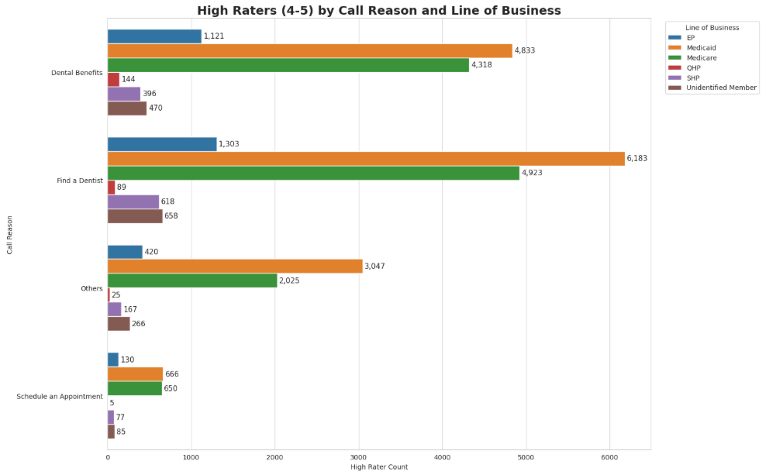
High raters
Call Reasons Driving Satisfaction
Call reasons
High-rated experiences are driven by “Find a Dentist” and “Dental Benefits”.
Medicare and Medicaid drive the majority of positive feedback.
Maintaining performance across these high-volume interactions will be critical to sustaining member satisfaction.
Notes:
High Raters are defined as FCR scored with 1 & 2, Ease, Informed, Courtesy and NPS Dental scored with 4 & 5 (based on total surveys received)
Where Satisfaction occurs, Which calls types are impacted. Questions that are “blank” are not graded by members; these are reformatted as “0” during data scrubbing.

Slide 12
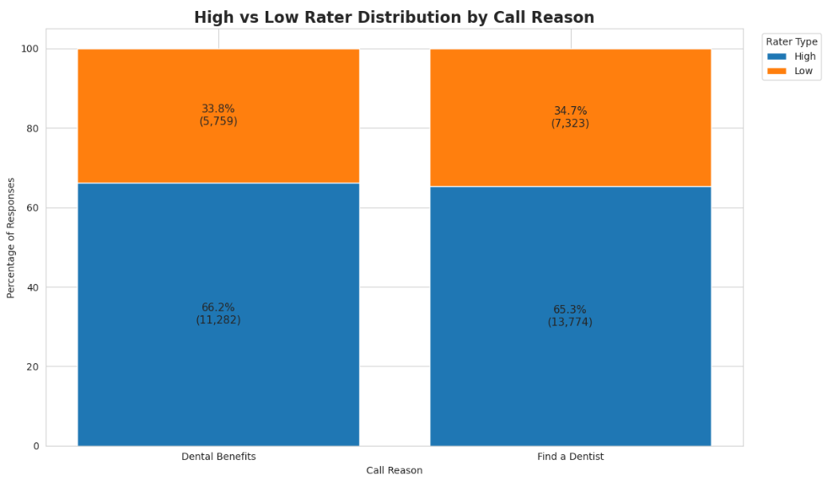
Comparison
Comparison of Top Call Drivers
Breakdown
Overall performance is strong, with most calls rated highly.
“Dental Benefits” = Continues to show strong member satisfaction and effective issue resolution.
“Find a Dentist” = Drives the highest call volume and represents the largest opportunity area for improving member experience.
*Note:
Low Raters = Scores 1 – 3
High Raters = Scores 4 - 5
Notes:
Focusing on top 2 Call Reason which happen to be top 2 high and low raters.
*Note: Counts differ from overall Call Reason totals because this analysis is based on survey rating criteria.

Slide 13

Summary
Medicare and Medicaid drive the highest survey volume, with “Find a Dentist” and “Dental Benefits” serving as the primary reasons members contact the call center.
While “Dental Benefits” demonstrates stronger overall performance, “Find a Dentist” remains the largest opportunity to improve member experience through enhanced provider support and agent guidance.

Slide 14

Thank you
Questions & discussion?
Diana Hatfield
Vendor Relationship Manager

Slide 15

Appendix
Survey definitions
High Raters
First Call (FCR) = Rating 1 - 2
Ease, Informed, Courtesy and NPS Dental = 4 - 5
Low Raters
First Call (FCR) = Ratings ≥ 3
Ease, Informed, Courtesy and NPS Dental = 1 – 3
Data Scope
January 2024 – April 2026
64,543 surveys analyzed
Post-call member survey responses
Data Preparation
Blank survey responses standardized as “0”
Survey fields were standardized for reporting consistency
Analysis focused on:
Call Reason
Line of Business
Member Satisfaction Indicators

